Slide 1
Backtracking
By
Rachit Bundela Priya Jain Sachin Hegde

Slide 2
Introduction
Backtracking is an algorithmic-technique for solving problems recursively by trying to build a solution incrementally, one piece at a time, removing those solutions that fail to satisfy the constraints of the problem at any point of time.
Backtracking can be defined as a general algorithmic technique that considers searching every possible combination in order to solve a computational problem.

Slide 3
Explanation
Backtracking algorithm is applied to some specific types of problems,
Decision problem used to find a feasible solution of the problem.
Optimisation problem used to find the best solution that can be applied.
Enumeration problem used to find the set of all feasible solutions of the problem.
In backtracking problem, the algorithm tries to find a sequence path to the solution which has some small checkpoints from where the problem can backtrack if no feasible solution is found for the problem.

Slide 4
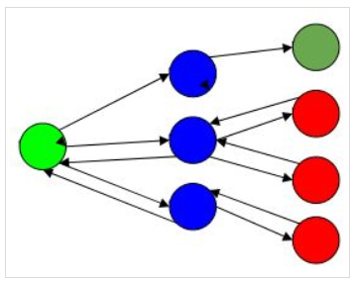
Working of backtracking
Green is the start point
Blue is the intermediate point
Red are points with no feasible
solution
Dark green is end solution
When the algorithm traverse to an end to check if it is a solution or not, if it is then returns the solution otherwise backtracks to the point one step behind it to find track to the next point to find solution.

Slide 5
How to determine if a problem can be solved using Backtracking?
Generally, every constraint satisfaction problem which has clear and well-defined constraints on any objective solution, that incrementally builds candidate to the solution and abandons a candidate (“backtracks”) as soon as it determines that the candidate cannot possibly be completed to a valid solution, can be solved by Backtracking

Slide 6
How to determine if a problem can be solved using Backtracking?
Consider a situation that you have three boxes in front of you and only one of them has a gold coin in it but you do not know which one. So, in order to get the coin, you will have to open all of the boxes one by one. You will first check the first box, if it does not contain the coin, you will have to close it and check the second box and so on until you find the coin. This is what backtracking is, that is solving all sub-problems one by one in order to reach the best possible solution.

Slide 7
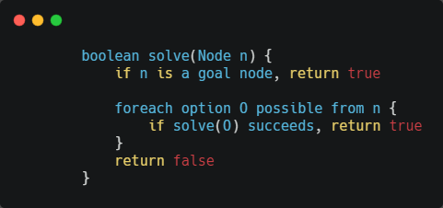
Pseudo Code for Backtracking :

Slide 8
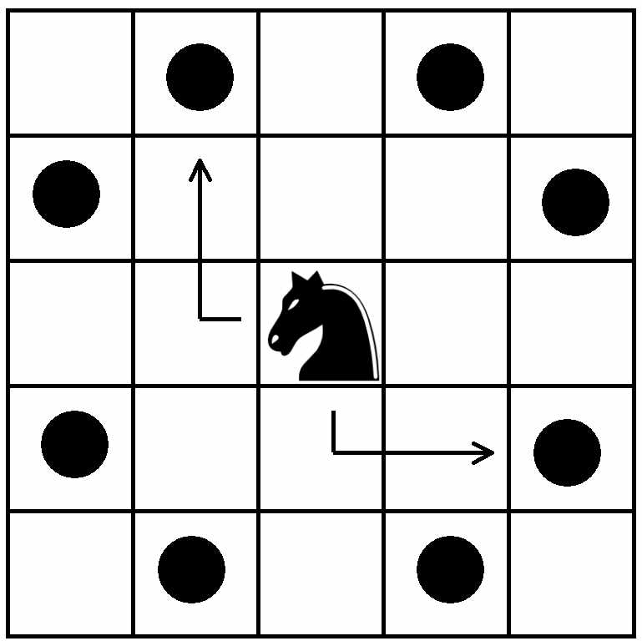
Example 1: The Knight’s tour problem
A knight's tour is a sequence of moves of a knight on a chessboard such that the knight visits every square exactly once

Slide 9
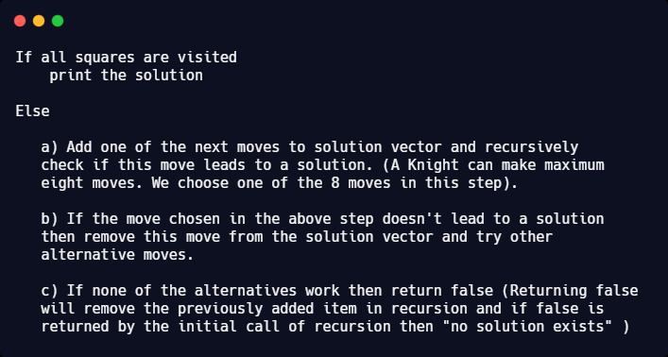
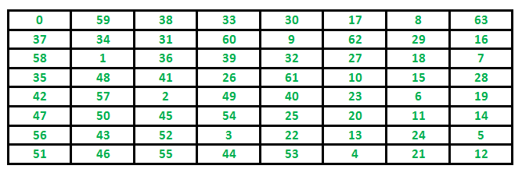

Slide 10
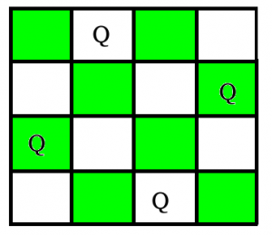
Example 2: N-Queen problem
In N-Queen problem, we are given an
NxN chessboard and we have to place
n queens on the board in such a way
that, No two queens attack each other.
A queen will attack another queen if it
is placed in horizontal, vertical or diagonal points in its way. In this example, we will do 4-Queen problem.

Slide 11
Example 2 continued...
For solving n queens problem, we will try placing queen into different positions of one row. And checks if it clashes with other queens. In the current positioning of queens if there are any two queens present, they are attacking. We will backtrack to previous location of the queen and change its positions. And check clash of queen again.

Slide 12
Algorithm for Example 2
Step 1 − Start from 1st position in the array.
Step 2 − Place queens in the board and check. Do,
a. After placing the queen, mark the position as a part of the solution and then recursively check if this will lead to a solution.
b. Now, if placing the queen doesn’t lead to a solution and trackback and go to step (a) and place queens to other rows.
c. If placing queen returns a lead to solution return TRUE.
Step 3 − If all queens are placed return TRUE.
Step 4 − If all rows are tried and no solution is found, return FALSE.

Slide 13
Example 3:Rat In Maze
A Maze is given as N*N binary matrix of blocks where source block is the upper left most block i.e., maze[0][0] and destination block is lower rightmost block i.e., maze[N-1][N-1]. A rat starts from source and has to reach the destination. The rat can move only in two directions: forward and down.
In the maze matrix, 0 means the block is a dead end and 1 means the block can be used in the path from source to destination.

Slide 14
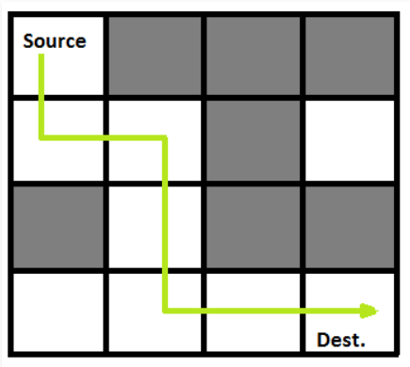
Example 3 continued...
Following is binary matrix representation of the maze.
{1, 0, 0, 0}
{1, 1, 0, 1}
{0, 1, 0, 0}
{1, 1, 1, 1}
Solution Matrix:
{1, 0, 0, 0}
{1, 1, 0, 0}
{0, 1, 0, 0}
{0, 1, 1, 1}

Slide 15
Algorithm for Example 3
Create a solution matrix, initially filled with 0’s.
Create a recursive function, which takes initial matrix, output matrix and position of rat (i, j).
if the position is out of the matrix or the position is not valid then return.
Mark the position output[i][j] as 1 and check if the current position is destination or not. If destination is reached print the output matrix and return.
Recursively call for position (i+1, j) and (i, j+1).
Unmark position (i, j), i.e output[i][j] = 0.

Slide 16


